Slide 1


David Santiago Martinez
9 august 2024

Slide 2

Outline
Executive Summary
Introduction
Methodology
Results
Conclusion
Appendix

Slide 3
Executive Summary
In this project we try to predict if rocket of Space Y can landing successfully or not in a platform having in mind a lot of variables like weight, orbit, booster version and so on. We collect information using web scrapping and using API’s, handling the missing values with pandas and searching information in the data set with SQL commands, after that we compare the different classification models (KNN, SVM, Tree & log regression) with Accuracy Score to find that the best Model is tree model and the orbits with more successful rate are ES-L1, GEO, HEO, SSO

Slide 4
Introduction
We will predict if the Falcon 9 first stage will land successfully. SpaceX advertises Falcon 9 rocket launches on its website with a cost of 62 million dollars; other providers cost upward of 165 million dollars each, much of the savings is because SpaceX can reuse the first stage. Therefore if we can determine if the first stage will land, we can determine the cost of a launch. This information can be used if an alternate company wants to bid against SpaceX for a rocket launch.

Slide 5

Section 1

Slide 6
Methodology
In this project we try to predict if rocket of Space Y can landing successfully or not in a platform having in mind a lot of variables like weight, orbit, booster version and so on. We collect information using web scrapping and using Space X API’s, after that handling the missing values with pandas and searching information in the data set with SQL commands to find some answers, after that wedivide the sample in two, one for training the models and one for testing the models, we compare the different classification models (KNN, SVM, Tree & log regression) with Accuracy Score to find that the best Model and using confusion matrix to answer our questions

Slide 7
Data Collection
The data were collected in two ways, the first one was with webscrapping on Wikipedia and the second one was with the Space x API
WEBSCRAPPING
API
Collect Data

Slide 8
Data Collection – SpaceX API
The process to obtain the info with SpaceX API was:
Link on GitHub :
https://github.com/santiago2025/Capstone-Project/blob/a198dda2f61ae1181ff904c851228e88fbd61277/jupyter-labs-spacex-data-collection-api.ipynb
Request to Api
Decode the response
second request for more rockets info
Put into a DF
Put into a DF
Preprocessing

Slide 9
Data Collection - Scraping
For WebScrapping we use The Wikipedia page and we Use the option from pandas to do this job with the function pd.read_html
Git hub link: https://github.com/santiago2025/Capstone-Project/blob/d59e4890529b0403003abdcef811136a6bf35b8e/jupyter-labs-webscraping.ipynb
Using pandas first import pandas as pd
Create a DF by Reading html and choose the correct table
Examinate the DF

Slide 10
Data Wrangling
Int this project we deal with some null values, and we changed by the mean, because we can’t find the real values and doesn’t affect the model
Link: https://github.com/santiago2025/Capstone-Project/blob/a198dda2f61ae1181ff904c851228e88fbd61277/jupyter-labs-spacex-data-collection-api.ipynb
Data Wrangling
Data Collection
EDA
Handling null values

Slide 11
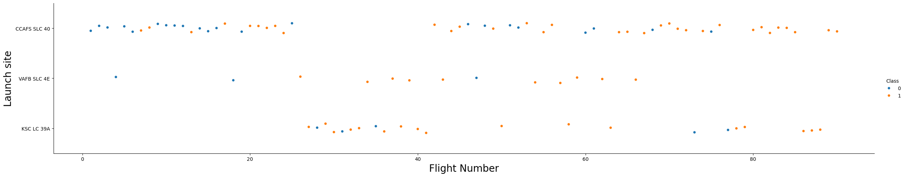
EDA with Data Visualization
We use Scatter plots to visualize the relations between some variables, the blue points show the flights that not landing, and the orange points the flights that landing successfully in the different launch sites
Link:https://github.com/santiago2025/Capstone-Project/blob/0e104e20bd7b8dca502b927720c19274f2f9b15e/edadataviz.ipynb
Fig1: Launch site vs Flights

Slide 12
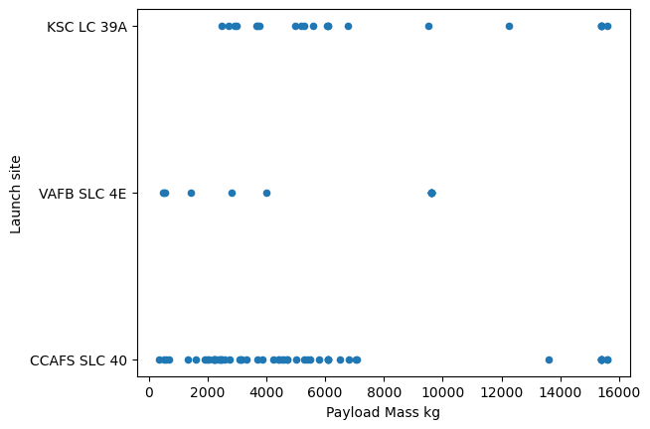
EDA with Data Visualization
We use Scatter plots to visualize the relations between some variables, in this case the Launch site vs Payload Mass in Kg
Link:https://github.com/santiago2025/Capstone-Project/blob/0e104e20bd7b8dca502b927720c19274f2f9b15e/edadataviz.ipynb
Fig1: Launch site vs Flights

Slide 13
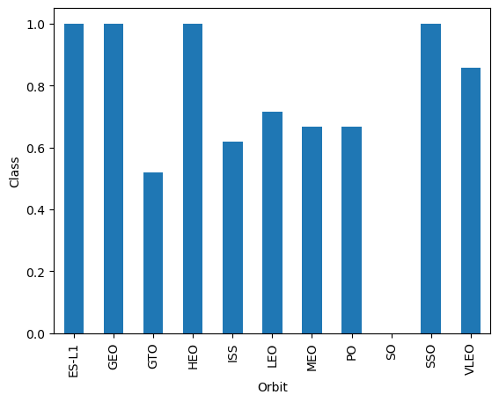
EDA with Data Visualization
We use bar plot to show the successful rate for each orbit flight
Link:https://github.com/santiago2025/Capstone-Project/blob/0e104e20bd7b8dca502b927720c19274f2f9b15e/edadataviz.ipynb
Fig3: succesfull rate for each orbit

Slide 14
EDA with SQL
Find the names of the launch sites
Display th total Payload Mass carried by Boosters Launched by NASA
Display average payload mass carried by booster version F9 v1,1
List the names of the boosters which have success in drone ship and have payload mass greater than 4000 but less than 6000
List the total number of successful and failure mission outcomes
List the names of the booster versions which have carried the maximum payload mass.
List the records which will display the month names, failure landing outcomes in drone ship ,booster versions, launch site for the months in year 2015.
First using SQL made the consultant list on the next list:
Link:https://github.com/santiago2025/Capstone-Project/blob/d804a2ba855fa2bc11ba0aedad0a7c5358f6acdd/jupyter-labs-eda-sql-coursera_sqllite.ipynb

Slide 15
Predictive Analysis (Classification)
After all visualizations decide to use one Classification model, because we need to classify labeled data and need to find the best model, for that reason I decide to train different models and compare with the accuracy score
https://github.com/santiago2025/Capstone-Project/blob/a7ffff53f79203e9096afc5143b510b250b457bf/SpaceX_Machine%20Learning%20Prediction_Part_5.ipynb
Normalize data
Split the data into test and train
Choose the model to evaluate (tree model, logistic regression, knn)
Train the model and made a gridsearch to find the best parameters
Find the accuracy of each model and compare

Slide 16
Results
The best model to predict the data set is knn model with an accuracy score of 0,848
The parameters of this model are the followings: neighbours number=10, ‘p’=1
https://github.com/santiago2025/Capstone-Project/blob/a7ffff53f79203e9096afc5143b510b250b457bf/SpaceX_Machine%20Learning%20Prediction_Part_5.ipynb

Slide 17

Section 2

Slide 18
Flight Number vs. Launch Site
Flight Number vs. Launch Site
Where blue dots are successful landings, and the orange are unsuccessful landings.
Could see in CCAFS SLC 40 were more launches

Slide 19
Payload vs. Launch Site
Payload vs. Launch Site
In this graph we can observe all launchs on different platforms, and we can observe there are not many heavy lunches above the 10,000 kg

Slide 20
Success Rate vs. Orbit Type
Success rate of each orbit type
We can observe there are 4 orbits with a 100% successful rate ( ES-L1, GEO, HEO, SSO)
There is no launches on SO and the worst successful rate i

Slide 21
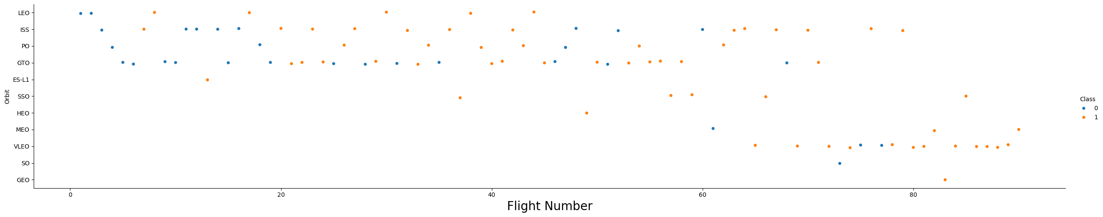
Flight Number vs. Orbit Type
Flight number vs. Orbit type where the orange points are successful and the blue ones unsuccessful
You can observe that in the LEO orbit, success seems to be related to the number of flights. Conversely, in the GTO orbit, there appears to be no relationship between flight number and success.

Slide 22
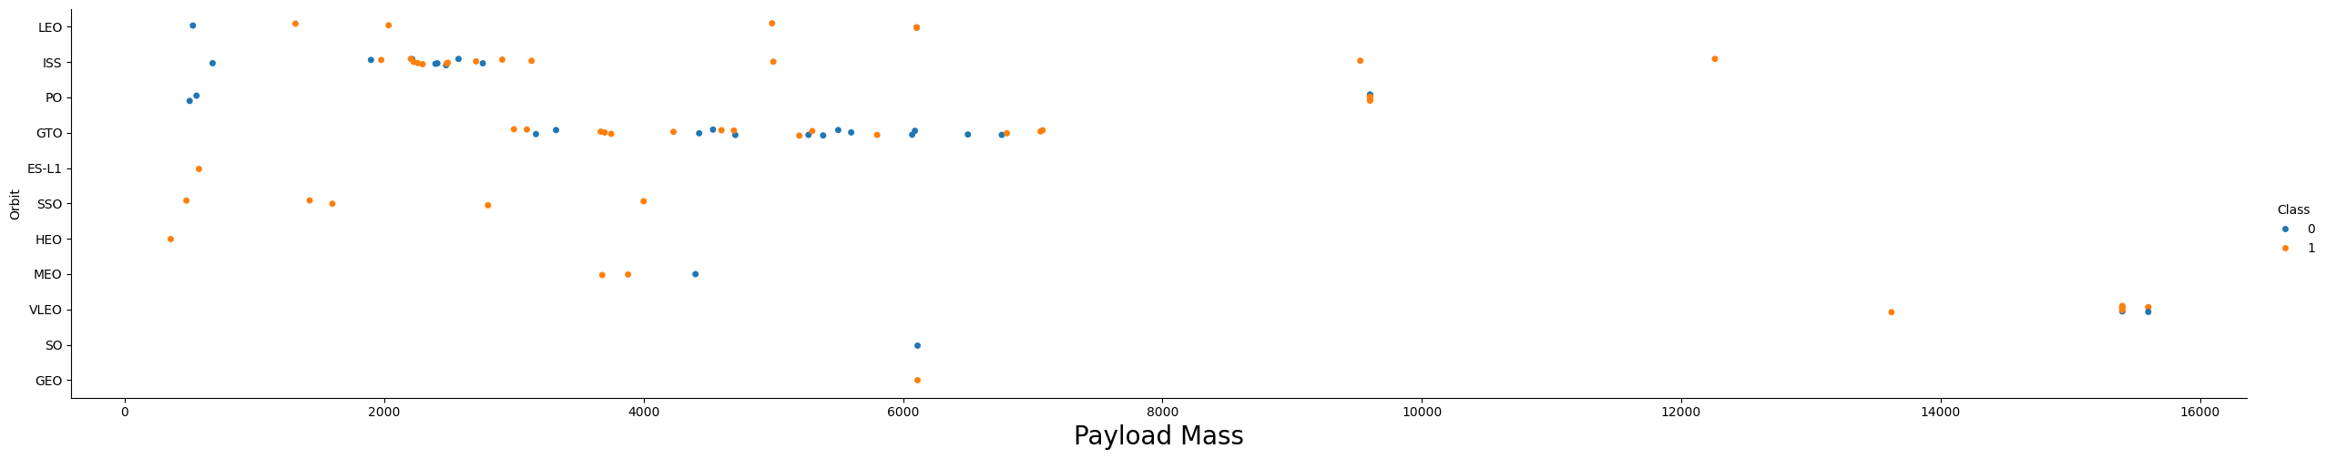
Payload vs. Orbit Type
Payload vs. Orbit type where the orange points are successful and the blue ones unsuccessful
With heavy payloads the successful landing or positive landing rate are more for Polar,LEO and ISS.However, for GTO, it's difficult to distinguish between successful and unsuccessful landings as both outcomes are present.

Slide 23
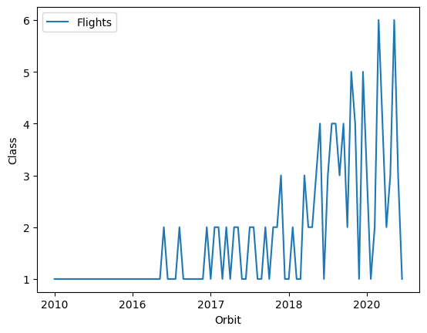
Launch Success Yearly Trend
Success yearly landing trends
We can observe after 2018 increase the number of successful landings

Slide 24
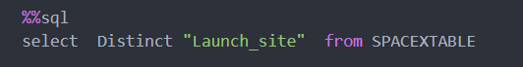
All Launch Site Names
Launch Sites
CCAFS LC-40
VAFB SLC-4E
KSC LC-39A
CCAFS SLC-40
Find the names with a SQL consult using function distinct

Slide 25
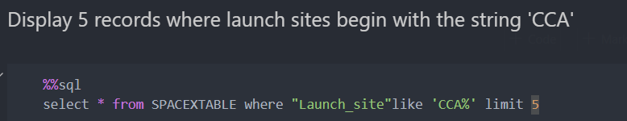
Launch Site Names Begin with 'CCA'
Using SQL commands find 5 site names that start witt CCA
Date | Time (UTC) | Booster Version | Launch_Site | Payload | PAYLOAD MASS KG | Orbit | Customer | Mission Outcome | Landing_Outcome
2010-06-04 | 18:45:00 | F9 v1.0 B0003 | CCAFS LC-40 | Dragon Spacecraft Qualification Unit | 0 | LEO | SpaceX | Success | Failure (parachute)
2010-12-08 | 15:43:00 | F9 v1.0 B0004 | CCAFS LC-40 | Dragon demo flight C1, two CubeSats, barrel of Brouere cheese | 0 | LEO (ISS) | NASA (COTS) NRO | Success | Failure (parachute)
2012-05-22 | 7:44:00 | F9 v1.0 B0005 | CCAFS LC-40 | Dragon demo flight C2 | 525 | LEO (ISS) | NASA (COTS) | Success | No attempt
2012-10-08 | 0:35:00 | F9 v1.0 B0006 | CCAFS LC-40 | SpaceX CRS-1 | 500 | LEO (ISS) | NASA (CRS) | Success | No attempt
2013-03-01 | 15:10:00 | F9 v1.0 B0007 | CCAFS LC-40 | SpaceX CRS-2 | 677 | LEO (ISS) | NASA (CRS) | Success | No attempt

Slide 26
Total Payload Mass
Calculate the total payload carried by boosters from NASA
We sum the payload carried by booter from NASA in SQL
PAYLOAD MASS KG total
45.596

Slide 27
Average Payload Mass by F9 v1.1
the average payload mass carried by booster version F9 v1.1
AVG PAYLOAD MASS KG
2534.6666666666665

Slide 28
First Successful Ground Landing Date
The date of the first successful landing outcome on ground pad
Date | Time (UTC) | BoosterVersion | Launch Site | Payload | PAYLOAD MASS Kg | Orbit | Customer | Mission Outcome | Landing Outcome
2015-12-22 | 1:29:00 | F9 FT B1019 | CCAFS LC-40 | OG2 Mission 2 11 Orbcomm-OG2 satellites | 2034 | LEO | Orbcomm | Success | Success (ground pad)

Slide 29
Successful Drone Ship Landing with Payload between 4000 and 6000
List the names of boosters which have successfully landed on drone ship and had payload mass greater than 4000 but less than 6000
Booster Version | PAYLOAD MASS Kg | Landing_Outcome
F9 FT B1022 | 4.696 | Success (drone ship)
F9 FT B1026 | 4.600 | Success (drone ship)
F9 FT B1021.2 | 5.300 | Success (drone ship)
F9 FT B1031.2 | 5.200 | Success (drone ship)

Slide 30
Total Number of Successful and Failure Mission Outcomes
Calculate the total number of successful and failure mission outcomes
Succesfull | Failure
61 | 40

Slide 31
Boosters Carried Maximum Payload
List the names of the booster which have carried the maximum payload mass
Booster Version | Date | Time (UTC) | Launch_Site | Payload | PAYLOAD_MASS__KG_ | Orbit | Customer | Mission Outcome | Landing Outcome
F9 B5 B1048.4 | 2019-11-11 | 14:56:00 | CCAFS SLC-40 | Starlink 1 v1.0, SpaceX CRS-19 | 15600 | LEO | SpaceX | Success | Success
F9 B5 B1049.4 | 2020-01-07 | 2:33:00 | CCAFS SLC-40 | Starlink 2 v1.0, Crew Dragon in-flight abort test | 15600 | LEO | SpaceX | Success | Success
F9 B5 B1051.3 | 2020-01-29 | 14:07:00 | CCAFS SLC-40 | Starlink 3 v1.0, Starlink 4 v1.0 | 15600 | LEO | SpaceX | Success | Success
F9 B5 B1056.4 | 2020-02-17 | 15:05:00 | CCAFS SLC-40 | Starlink 4 v1.0, SpaceX CRS-20 | 15600 | LEO | SpaceX | Success | Failure
F9 B5 B1048.5 | 2020-03-18 | 12:16:00 | KSC LC-39A | Starlink 5 v1.0, Starlink 6 v1.0 | 15600 | LEO | SpaceX | Success | Failure
F9 B5 B1051.4 | 2020-04-22 | 19:30:00 | KSC LC-39A | Starlink 6 v1.0, Crew Dragon Demo-2 | 15600 | LEO | SpaceX | Success | Success
F9 B5 B1049.5 | 2020-06-04 | 1:25:00 | CCAFS SLC-40 | Starlink 7 v1.0, Starlink 8 v1.0 | 15600 | LEO | SpaceX, Planet Labs | Success | Success
F9 B5 B1060.2 | 2020-09-03 | 12:46:14 | KSC LC-39A | Starlink 11 v1.0, Starlink 12 v1.0 | 15600 | LEO | SpaceX | Success | Success
F9 B5 B1058.3 | 2020-10-06 | 11:29:34 | KSC LC-39A | Starlink 12 v1.0, Starlink 13 v1.0 | 15600 | LEO | SpaceX | Success | Success
F9 B5 B1051.6 | 2020-10-18 | 12:25:57 | KSC LC-39A | Starlink 13 v1.0, Starlink 14 v1.0 | 15600 | LEO | SpaceX | Success | Success
F9 B5 B1060.3 | 2020-10-24 | 15:31:34 | CCAFS SLC-40 | Starlink 14 v1.0, GPS III-04 | 15600 | LEO | SpaceX | Success | Success
F9 B5 B1049.7 | 2020-11-25 | 2:13:00 | CCAFS SLC-40 | Starlink 15 v1.0, SpaceX CRS-21 | 15600 | LEO | SpaceX | Success | Success

Slide 32
2015 Launch Records
List the failed landing_outcomes in drone ship, their booster versions, and launch site names for in year 2015
Present your query result with a short explanation here
month | Date | Time (UTC) | BoosterVersion | Launch Site | Payload | PAYLOAD MASS KG | Orbit | Customer | Mission Outcome | Landing Outcome
01 | 2015-01-10 | 9:47:00 | F9 v1.1 B1012 | CCAFS LC-40 | SpaceX CRS-5 | 2395 | LEO (ISS) | NASA (CRS) | Success | Failure (drone ship)
04 | 2015-04-14 | 20:10:00 | F9 v1.1 B1015 | CCAFS LC-40 | SpaceX CRS-6 | 1898 | LEO (ISS) | NASA (CRS) | Success | Failure (drone ship)

Slide 33
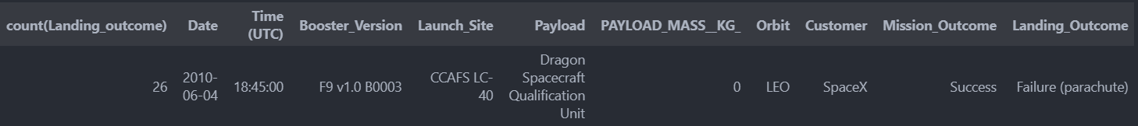
Rank Landing Outcomes Between 2010-06-04 and 2017-03-20
Rank the count of landing outcomes (such as Failure (drone ship) or Success (ground pad)) between the date 2010-06-04 and 2017-03-20, in descending order
Present your query result with a short explanation here

Slide 34

Section 3

Slide 35
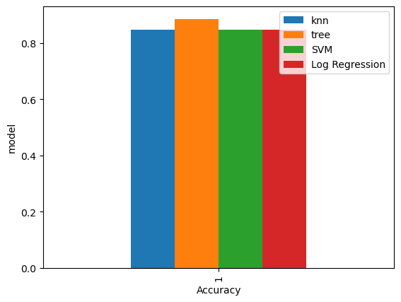
Classification Accuracy
Visualization the built model accuracy for all built classification models, in a bar chart
The model with the highest accuracy is Tree model

Slide 36

Confusion Matrix
Show the confusion matrix of the best performing model with an explanation

Slide 37
Conclusions
The best model to predict if a landing going to be successfully is tree model
Sql help us to find some special cases in our data set
We can observe there are 4 orbits with a 100% successful rate ( ES-L1, GEO, HEO, SSO)

Slide 38


